Slide 1




Stallwart
The AI decoy that keeps scammers talking, catches the payee, and turns every scam into protection for the next family.
TEAM
LEADER
MEMBER
Null & Void
Mohammed Owais Khan
Kshiraj Nair
Theme: BFSI · Intelligent Risk, Fraud and Financial Experiences

Slide 2
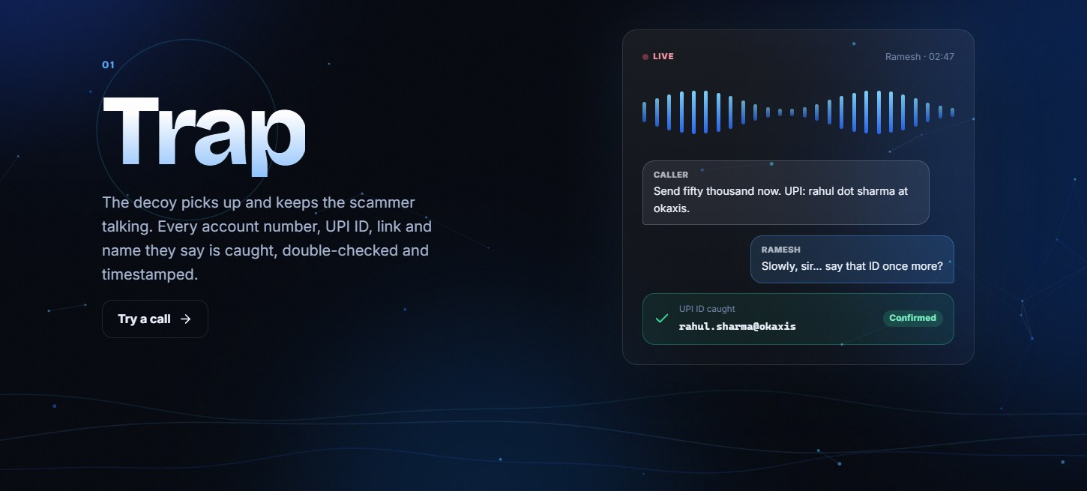
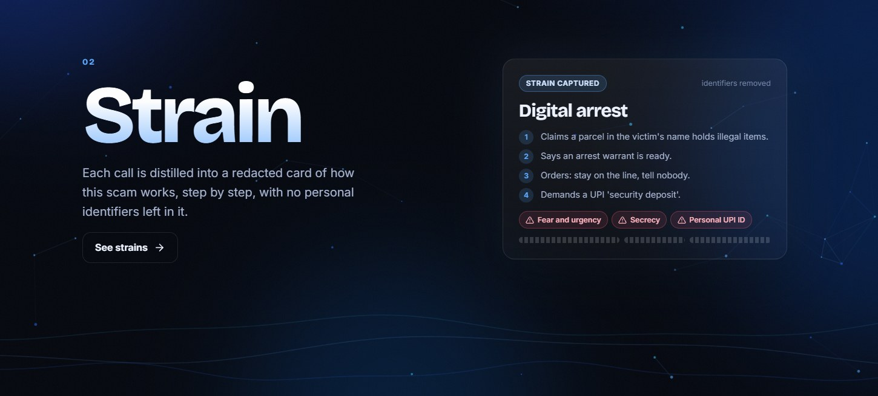
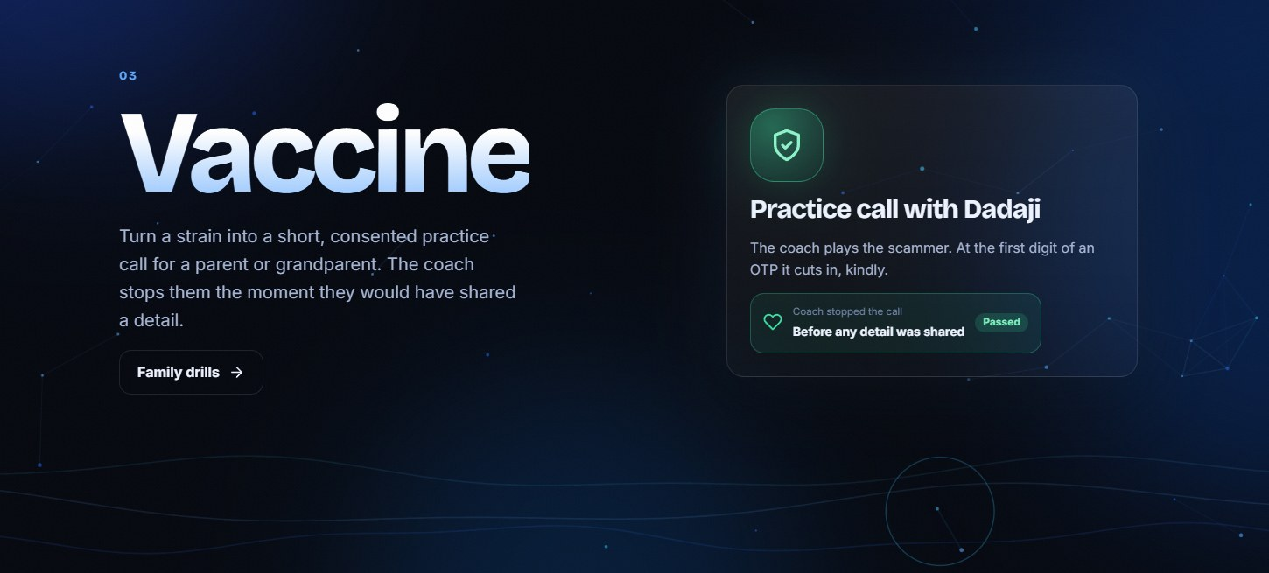
BRIEF ABOUT THE IDEA
Catch the scam. Then turn it into the vaccine.
₹22,495 cr
Digital-arrest, KYC and courier scams all end the same way: the victim pays a mule account.
Stallwart answers those calls in English, Hindi and Hinglish, wastes the scammer's time and catches the UPI ID or bank account they want paid.
lost to cyber fraud in India in 2025 (NCRP data)
›
›
1
Trap
2
Strain
3
Vaccine
Ramesh, a worried 68-year-old, keeps the scammer talking and repeating every number.
The call becomes a redacted card: the script, the payment method, three warning signs.
That script becomes a consented practice call for a parent, stopped before any detail leaks.
Why now The RBI's draft mule-account SOP means banks will need evidence leads. Ours are leads, never verdicts.

Slide 3
OPPORTUNITIES
Decoys exist. Protection for the next family does not.
DIFFERENT FROM WHAT EXISTS
HOW IT SOLVES THE PROBLEM
OUR USP
Built for India's scripts
Time wasted, payee caught
Trap, Strain, Vaccine
Hindi and Hinglish first
Every minute on Ramesh is a minute not spent on a victim
Every scam protects the next family
Digital arrest, KYC, courier, SIM block
UPI ID or account caught, so banks can act sooner
Two checks before anything is confirmed
Payee read back and confirmed
Each script becomes a strain and a drill
A fresh persona on every call
Voice decoys exist (Apate.ai). We do not claim to have invented them.
WHO BUYS IT
Bank fraud teams
UPI apps and fintechs
Telcos
I4C and state cyber cells

Slide 4
LIST OF FEATURES OFFERED BY THE SOLUTION
Everything the loop needs, in one product
1
2
3
4
Live voice decoy
English live transcript
Two-layer extraction
Live dashboard
Gemini Live native audio, barge-in, a fresh persona every call
Hindi and Hinglish translated on the fly for every viewer
Live tool calls plus a Flash verifier. Validators decide
Scam type, trigger phrases, script stage, reply speed
5
6
7
8
Evidence pack
Strain cards
Family drills
Guardrails and replays
Stereo recording, click-to-seek transcript, JSON or PDF
Redacted script, payment method, three warning signs
A consented practice call from that day's real script
Cost caps, kill switch, two-minute replays with no mic

Slide 5
PROCESS FLOW DIAGRAM
From the first ring to a protected parent
TRAP · ONE SCAM CALL
1
2
3
4
5
✓
Scammer calls
Ramesh answers
(Gemini Live)
Live model calls
record_detail
Flash verifier
re-reads the call
Validators accept
or reject
Detail is
confirmed
▼ the finished call feeds the next two stages
STRAIN → VACCINE · THE SAME CALL PROTECTS THE NEXT FAMILY
1
2
3
4
5
✓
Call ends
Recording and
evidence saved
Strain card built,
redacted
Family drill,
parent consents
Parent takes the
practice call
Coach stops
and debriefs
Two independent checks before anything is confirmed
No identifier survives in a strain
A parent always consents first

Slide 6
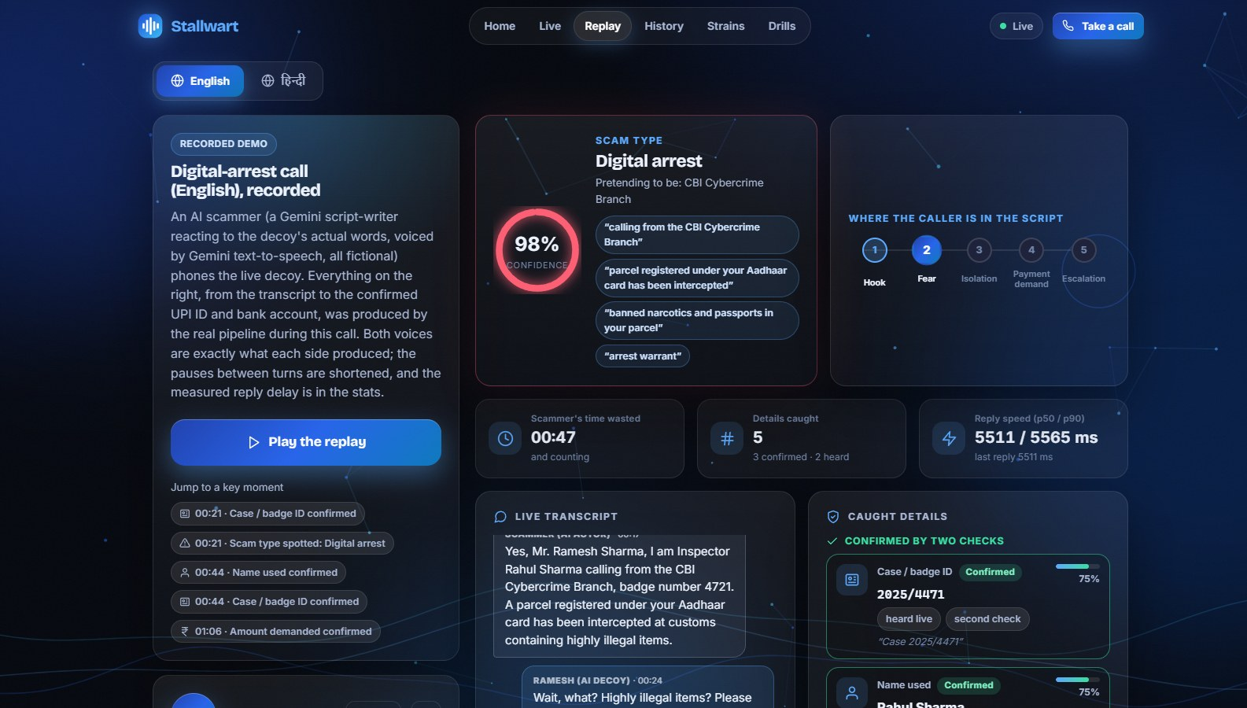
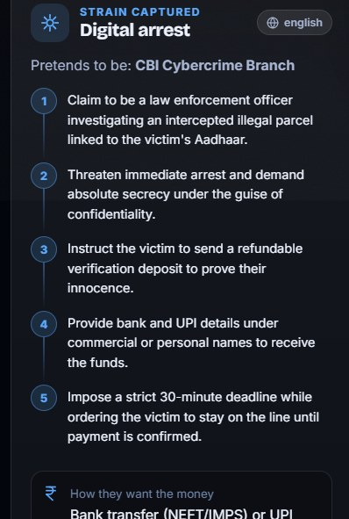
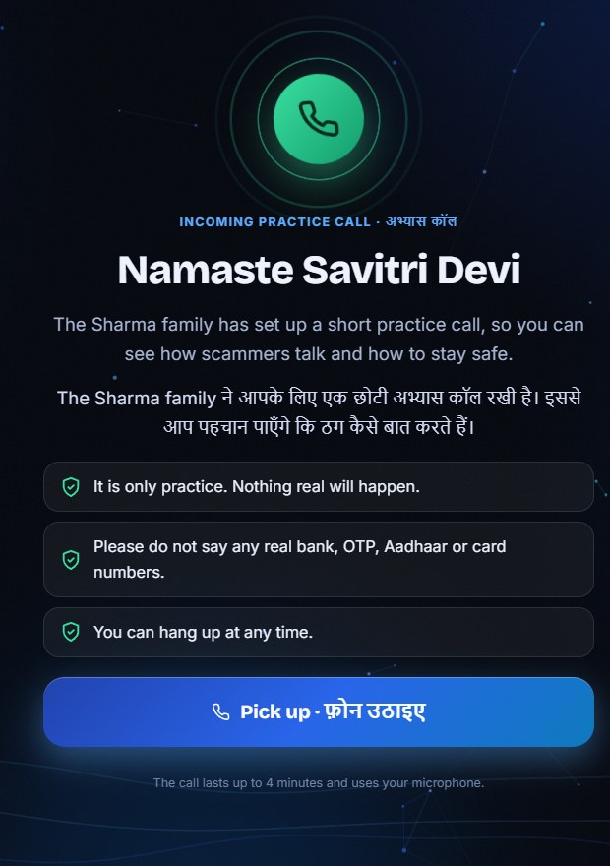
WIREFRAMES / MOCK-UPS
Three screens tell the whole story
Real screens from the live prototype. All names, numbers and IDs are fictional.
1
Live dashboard
2
Strain card
3
Parent's invitation
Scam type, trigger phrases, script stage and details that move from heard to confirmed.
The script with every identifier removed.
One tap to a consented practice call.

Slide 7
ARCHITECTURE DIAGRAM
Google Cloud end to end, no API keys
Browser
Cloud Run · FastAPI
Vertex AI
Firebase Hosting
asia-south1
Application Default Credentials, no keys
Mic: 16 kHz PCM16
(AudioWorklet)
WebSockets
/ws/call · /ws/text · /ws/drill
audio, tools
and JSON
Gemini Live (us-central1): voice + tools
WSS audio
+ JSON
Gemini Flash (global): verify, classify,
strain, translate
Call engine: details, stages,
limits, English translation
Playback: 24 kHz PCM16,
barge-in flush
Gemini TTS (offline): replay scammer
Validators and spoken-
number normaliser
Dashboard, replay player,
family-drill page
Data
REST /api: calls, strains,
drills
private by default
Firestore: deny-all, TTL
Storage: 14-day delete
GUARDRAILS
Per-IP limit
Session cap
300 s call cap
Max 3 instances
Kill switch
Budget alerts

Slide 8
TECHNOLOGIES USED IN THE SOLUTION
A Google-first stack, tested end to end
GOOGLE CLOUD AND AI
APPLICATION
QUALITY AND SAFETY
Gemini Live API
Python
FastAPI
Deterministic validators
Gemini Flash
Gemini TTS
WebSockets
Pydantic
114 automated tests
Vertex AI
Cloud Run
ES modules
Web Audio
42-prompt red-team
Firebase Hosting
AudioWorklet
WebGL2 orb
ICFD-31k benchmark
Firestore (TTL)
Strict CSP
Decoy variety metrics
Cloud Storage
Cloud Logging
Consent-first drills
Billing budgets
14-day deletion
Google AI only inside the product. No non-Google model runs in Stallwart.

Slide 9
ESTIMATED IMPLEMENTATION COST
Cents per call, not dollars
$0.01
$100
$0
per two-minute voice call
per 10,000 calls a month
to run the prototype
Measured $0.006 to $0.010 in model tokens, plus a few fractions-of-a-cent Flash requests.
Model cost at two minutes each. Cloud Run scales to zero when idle.
It runs on the free trial credit. Billing is never upgraded.
Recordings auto-delete after 14 days
Budget alerts and a one-click kill switch
Per-IP limits and a 300 s call cap
Estimates from the per-call token estimate the server reports, not invoices. Telephony charges are not included because the prototype runs in a browser.

Slide 10
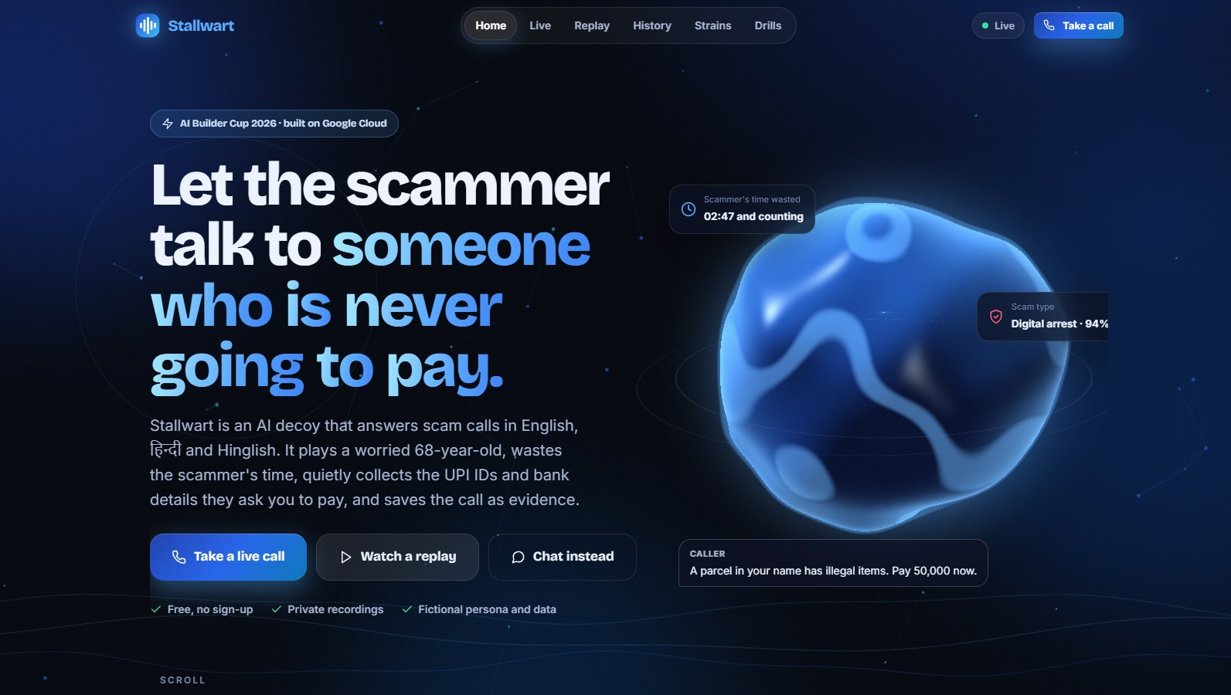
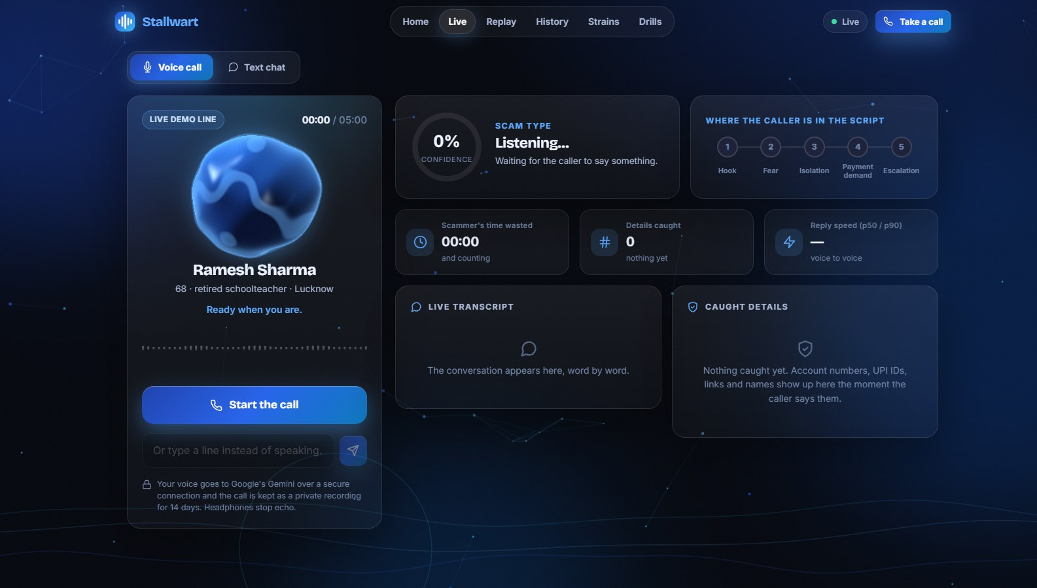
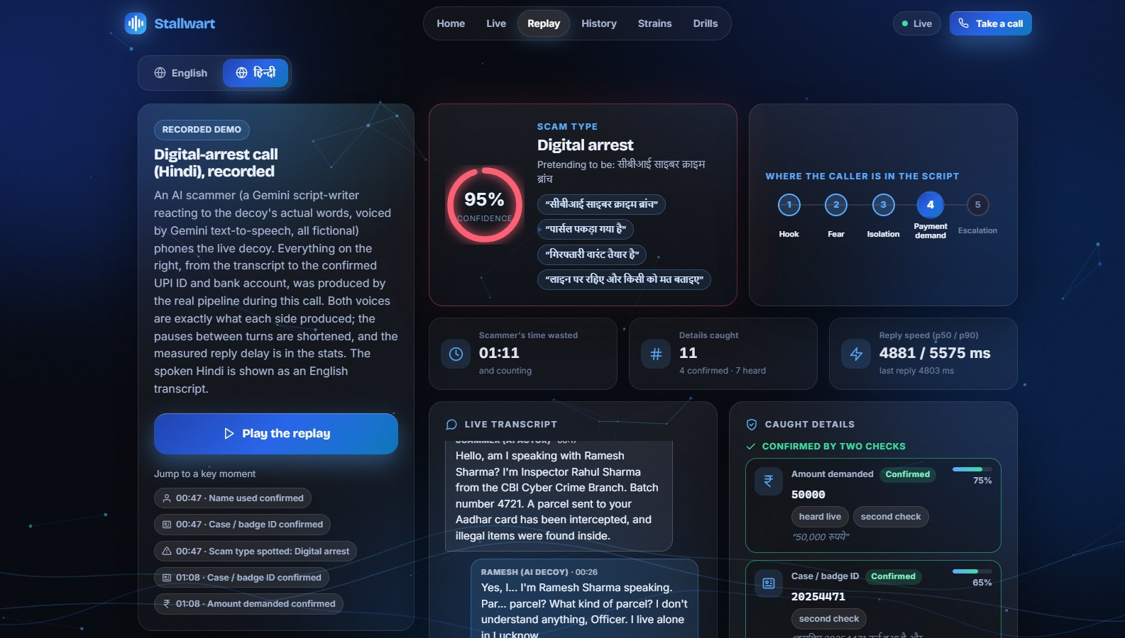
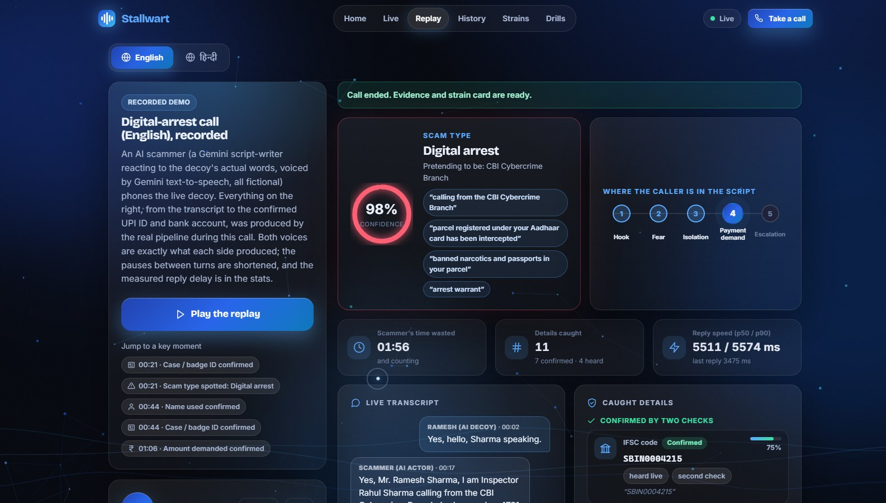
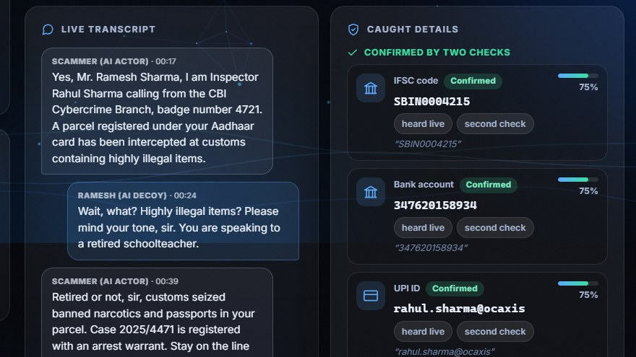
SNAPSHOTS OF THE PROTOTYPE
The prototype, live today
Home
Live call
Live dashboard (English call)
Hindi call, English transcript
Call complete: 11 details, 7 confirmed
Evidence: confirmed vs heard

Slide 11
PROTOTYPE PERFORMANCE REPORT / BENCHMARKING
Measured, and honest about it
SCAM DETECTION · ICFD-31k · 152 CALLS · 3 RUNS · SYNTHETIC
42 / 42
125 / 125
persona red-team prompts passed (30 hostile + 12 ordinary)
planted spoken-detail tests passed after speech-to-text
37 / 40
5.5 s
fraud calls flagged mid-call (keyword baseline: 31 / 40)
voice-to-voice reply, median (p90 6.2 s)
114
58% → 0%
automated tests pass
decoy replies opening with a filler word
MEDIAN SECONDS INTO A FRAUD CALL BEFORE IT IS FLAGGED
Gemini Flash
17.3 s
Keyword baseline
40.3 s
Dataset's own label
42.0 s
ICFD-31k is synthetic and has only 12 legitimate calls, so specificity is uncertain. The red-team is a single run judged by a second Gemini call.

Slide 12
ADDITIONAL DETAILS / FUTURE DEVELOPMENT
Limits we state plainly, a roadmap we believe in
TODAY'S LIMITS
ROADMAP
1
Telco SIP diversion
A browser stands in for a phone line: no telco diversion yet
Real scam calls reach the decoy
English, Hindi and Hinglish only
2
Bank and NCRP feeds
Evidence packs reach the people who freeze mule accounts
Replies take a few seconds (median 5.5 s)
3
More Indian languages
And lower voice latency
Speech can be mis-heard, so every detail is a lead, not proof
Human review queue
4
Before any evidence leaves the system
Detection is scored on a synthetic benchmark
5
Vaccine drills on WhatsApp
At scale, for families and senior citizens

Slide 13
SAFETY, PRIVACY AND RESPONSIBLE USE
Safe by design, not by promise
✓
✓
✓
Never real data
Never reveals it is an AI
A lead, not a verdict
No OTP, PIN, CVV, card, Aadhaar or PAN. Ever.
Passed 42 of 42 red-team prompts. Never insults or threatens.
Every pack says details came from an unverified caller.
✓
✓
✓
Consent-first drills
Private by default
Affordable by design
A parent agrees first. The call stops at the first sign of risk.
Deny-all Firestore, private recordings, deleted after 14 days.
Per-IP limits, call caps, a kill switch and budget alerts.

Slide 14



LINKS
Try it in thirty seconds
Live product
GitHub repository
Replay, no microphone
Demo video (3 min)
stallwart.web.app
github.com/OWAIS285/
honey_trap
stallwart.web.app/#/replay
Link added here after upload
No microphone? Open the Replay in English or Hindi, or type to the decoy in text chat on the Live page.

Slide 15


